Slide 1
Virtual Memory
Pavel Kryukov
29.03.2019

Slide 2
Layers of Abstraction in Computer Science
Application
Algorithms
Programming Language
Operating System
Topics of
this lecture
Instruction Set Architecture
Microarchitecture
Gates/Register-Transfer Level (RTL)
Circuits
Physics

Slide 3
Agenda
Refresher on OS course: virtual memory
Page table
TLB
Virtual-memory related HW optimizations

Slide 4
Refresher: Virtual Memory

Slide 5
Refresher: Memory managing
Initially, resources was managed manually by SW developer
One program (= process) occupied the whole machine recourses
There was no “external” programs with unknown code/requirements
Modern requirements
Multi-tasking → not effective to give all resources to one process
Many SW → cannot plan their co-existents anymore
How multiple process share the memory?
What happens if a process tries to access memory of another process?
What happens if processes need more memory and there is no free one?
What happens if a new process is spawned?
address 0
address N
Process A
Process B
Process C

Slide 6
Refresher: Virtual Memory
Isolation between processes
Processes can concurrently run on a single machine
VM prevents them from illegal accessing the memory of one another
Allows convenient sharing of memory for communication when required
Illusion of large memory for each process
VM size can be bigger than physical memory size
VM decouples program from real size (can differ across machines)
Contiguous memory illusion
Programmers need not worry about where data is placed exactly
Dynamic growth
Can add memory to processes at runtime as needed
Over commitment
Sum of VM spaces (across all processes) can be >> physical space
Memory often one of the most costly parts in the system

Slide 7
Virtual and Physical Address Space
Virtual address space
Space used by the programmer (part of program visible state)
Perfect abstraction = contiguous and completely belongs to the process
Physical address space
The real physical memory (e.g., DRAM) available in the computer
Not known by the programmer (completely hidden by OS/HW)
How to map virtual space to physical one?

Slide 8
Basic Idea of VM
Split both virtual and physical spaces into fixed size blocks called pages (commonly 4KB)
Not need to place the whole virtual space into the computer → only pages used by the process
Pages can be in physical memory or disk
Memory acts as a cache for the secondary storage (disk)
Process may use more pages that physical memory can keep
Each process can access only their pages
#page
0
1
2
3
4
5
6
…
…
91
92
93
…
…
Physical Space
Virtual Space
#page
2
19
40
41
Disk
#page
60
122

Slide 9
Page Table

Slide 10
Page Table
To perform translation of virtual address into physical one, the special structure called Page Table (PT) is used
It contains the following information for each page:
Whether the page is in memory or on the disc
Physical address of the page (if it is in memory)
Was its data modified? → need for evictions
Access rights (read-only, read-write, etc.) → security
Each process has its own PT
HW uses PT to translate addresses
But, all complex tasks (initialization, misses, evictions, etc.) are performed by OS

Slide 11
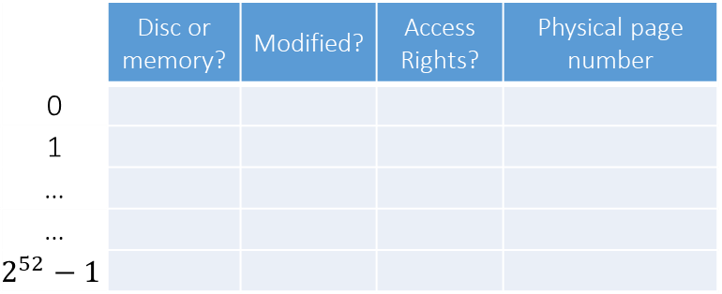
Translation
Virtual Address
63 | 11 | 0
Virtual Page Number | Page Offset
Page Table
 | Disc or memory? | Modified? | Access Rights? | Physical page number
0
1
…
…
$$2^{52}−1$$
31 | 11 | 0
Physical Page Number | Page Offset
Physical Address

Slide 12
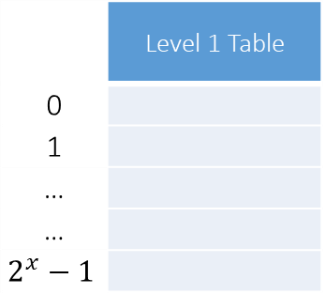
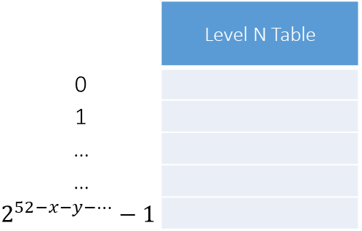
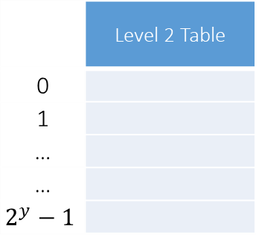
Page table structure
Page table implementation is defined by OS
Usually it is a multi-level table
Accessing of final page table entry is a chain of loads (“walk”)
63 | 11 | 0
Virtual Page Number | Page Offset
31 | 11 | 0
Physical Page Number | Page Offset
 | Level 1 Table
0
1
…
…
$$2^{x}−1$$
 | Level 2 Table
0
1
…
…
$$2^{y}−1$$
 | Level N Table
0
1
…
…
$$2^{52−x−y−…}−1$$
...
29.03.2019
MIPT-MIPS 2018

Slide 13
Page fault
Page fault is inability to translate address
Control is given to OS to perform action, like in exception case
If page is on disk, OS loads page to memory and adds PT entry
If page was not allocated, segmentation fault exception is raised

Slide 14
Context protection
One process must not access physical memory of another process
Each process has its own page table therefore
How to write to PT? CPU works in 2 modes at least
Kernel mode:
entered by syscall
has write access to PT
knows what physical addresses are
User mode:
return from kernel mode by eret instruction
operates only with own PT in a read-only manner

Slide 15
Translation Lookaside Buffer

Slide 16
TLB
The PT is too huge to be in HW → it is stored in memory
There are multiple methods to compact it
Each translation requires several memory accesses
Needed for every load or store → too many!
Data cache helps, but not much
TLB caches recently used PT entries
speed up translation
typically 64 to 256 entries
usually 2 to 8 way associative
TLB access time is faster than L1 cache access time
Virtual Address
TLB Access
Access
Page Table
No
TLB Hit ?
Yes
Physical
Addresses

Slide 17
PT, TLB and Cache
Virtual Address
Access
TLB
Access
Cache
Access
Page Table
In Memory
L2 Cache
Hit ?
No
L1 Cache
Hit ?
L2 Cache
Hit ?
No
TLB
Hit ?
No
No
Access
Memory
Yes
Yes
Physical
Addresses
Data

Slide 18
Handling TLB miss
MIPS traditionally handles TLB miss by software:
Exception is raised, control is given to OS
OS fetches PT entry and fills it contents to TLB
x86 does it with hardware
RISC-V allows both

Slide 19
TLB Protection
Simplest solution — flush TLB on context switch
Not optimal if “new” context switches back early
Performance-friendly solution — process id is a part of TLB tag
Translate for different contexts simultaneously
Safe, one context will not read TLB entries of other contexts

Slide 20
Vulnerabilities
Speculation and context protection are self-contradicting
Leads to vulnerabilities like Meltdown or TLBleed
lw $r1, 0x0($r2) # attempts to read kernel-space memory # raises exception at retirement
andi $r1, $r1, 0x1 # read bit 0 (may be any)
slli $r1, $r1, 0x40 # get a cache line offset
addi $r3, $r3, $r1 # speculatively fetch data to cache # on [$r3] or [$r3 + 0x40]
// ...
lw $r4, 0x0($r3) # measure time of instruction to check if cache # miss or hit

Slide 21
HW optimizations

Slide 22
Optimization 1: overlapped TLB & cache access
38
11
0
Virtual Memory view of a Physical Address
Physical Page Number
Page offset
6
5
0
Cache view of a Physical Address
tag
set
disp
#Set is contained within the Page Offset
The #Set is known immediately
Cache can be accessed in parallel with address translation
Once translation is done, match upper bits with tags
Limitation: Cache ≤ (page size × associativity)

Slide 23
Optimization 2: virtually-addressed cache
Address translation only done on a cache miss
Problem 1: two virtual pages mapped to the same physical page
Must not reside in the cache together
On a cache miss, use a reverse TLB to verify that no other cache line already in the cache mapped to the missed physical address
Problem 2: flush cache on context switch
Alternatively: add process ID as part of the tag
CPU
data
Cache
data
Main
Memory
VA
TLB
PA

Slide 24
Open questions: free discussion
What address should be used for store forwarding?
What address space should be used for prefetching logic?

Slide 25
Thank You

